Slide 1
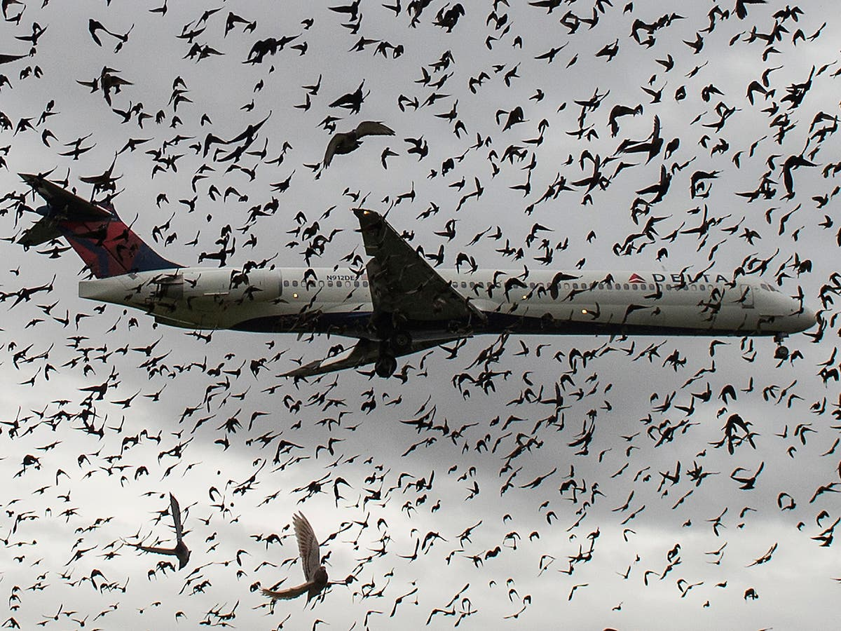
Data Visualization of Bird Strikes between 2000-2011
Name : N Harsha Moulika
Domain : Data-Science

Slide 2
Project Detail
Project Title | Data Visualization of Bird Strikes between 2000-2011
Technology | Data Science
Domain | Transportation and Communication
Project Difficulty Level | Advanced
Programming Language Used | Python Programming
Tools used | Jupyter Notebook, MS-Excel, Power Point

Slide 3
Objective
Transportation and Communication Analytics:
Environmental impacts and safety are major concerns in transportation
Especially with increasing vehicles and population.
New solutions are needed to address these issues.
Artificial intelligence and Multi-Agent Systems can help tackle these problems in a distributed and effective way.
Bird Strike Problem :
Definition: Collision between a bird and an aircraft in flight, take-off, or landing.
Expanded definition: Includes collisions with bats or ground animals.
Impact: Significant threat to aircraft safety, especially for smaller aircraft.
Consequences: Damage to aircraft structure, loss of thrust, and potentially fatal accidents.
Most likely phases for bird strikes: Take-off, initial climb, approach, and landing.

Slide 4

Problem Statement
Goal: Analyze bird strike incidents between 2000-2011 using data science techniques in Python to gain insights into the data.
Data: FAA dataset collected between 2000-2011.Objectives
Objectives:
*Perform data visualization using Python libraries to understand insights of the data.
*Apply data science techniques using Python (e.g., Pandas, NumPy, Scikit-learn) for data analysis, machine learning, and visualization.
Expected Outcomes:
*Insights into trends, patterns, and correlations in the data.
*Predictive models to forecast bird strike incidents.
*Data visualizations to communicate findings effectively.

Slide 5
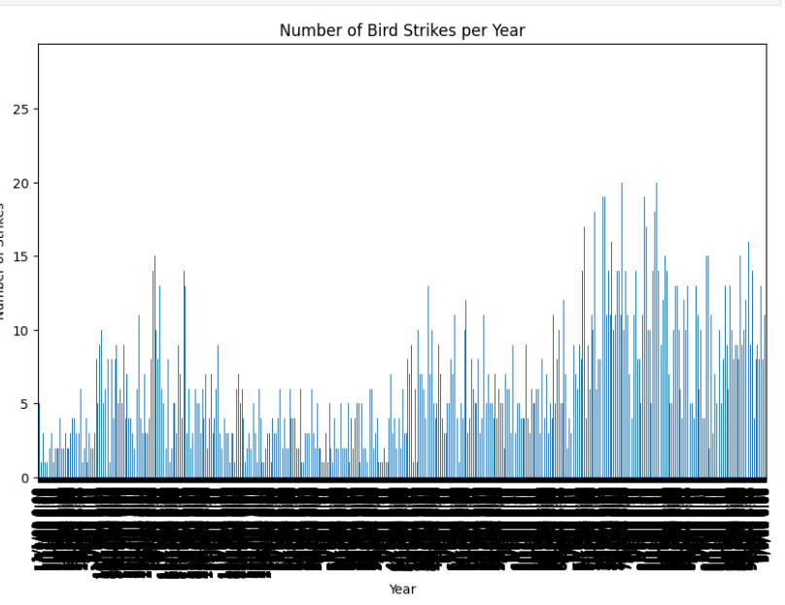
CASE STUDY
Number of birds strikes per year
The graph shows a clear seasonal pattern, with a peak in bird strikes during the summer months (June to August) and a decrease in winter months (December to February). This could be due to various factors such as bird migration patterns, weather conditions, or increased air traffic during summer.

Slide 6
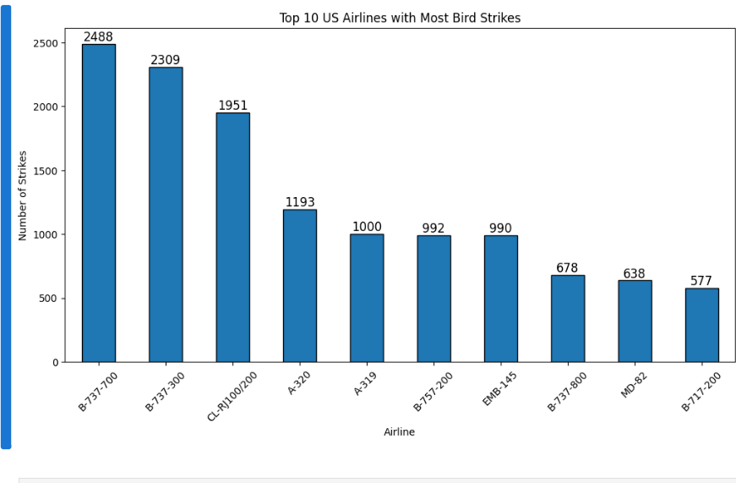
Top 10 US Airlines in terms of having encountered bird strikes
The graph shows the top 10 US airlines that have encountered the most bird strikes, with American Airlines, Delta Air Lines, and United Airlines being the top three. This indicates that these airlines may need to take extra precautions to mitigate bird strike risks..

Slide 7
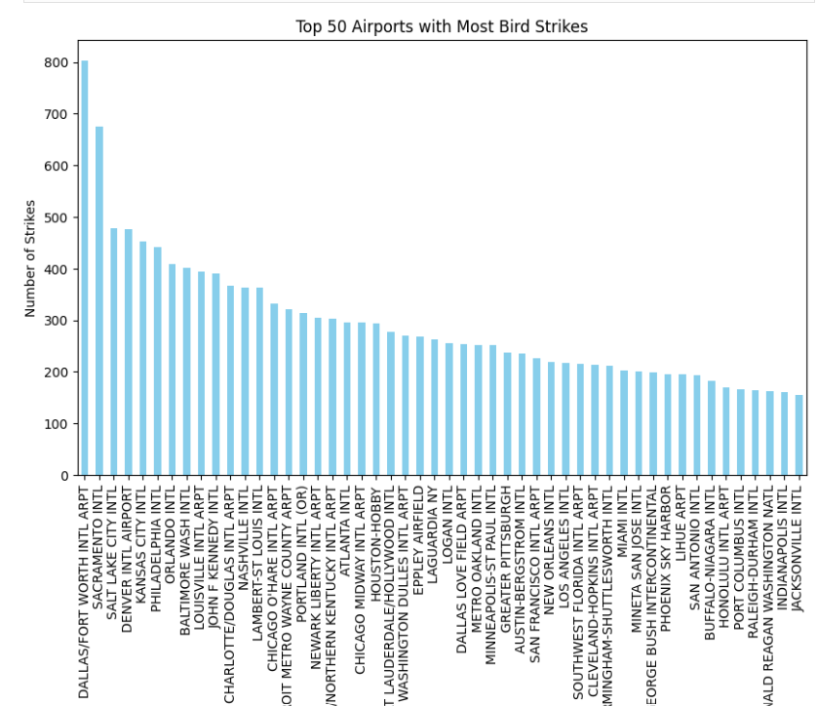
Airports with most incidents of bird strikes – Top 50
The top 50 airports with the most bird strikes are led by Chicago O'Hare International Airport (ORD) and New York LaGuardia Airport (LGA), indicating a need for targeted bird strike prevention measures at these locations. The variation in bird strike frequency among airports highlights the importance of airport-specific strategies to mitigate this safety risk.

Slide 8
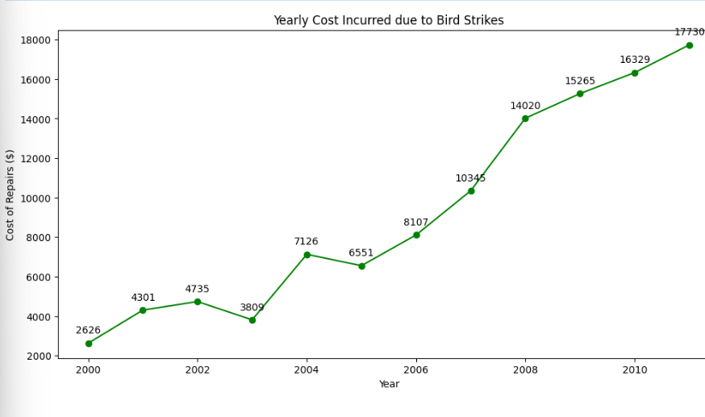
Yearly Cost Incurred due to Bird Strikes
The yearly cost incurred due to bird strikes between 2000 and 2011 is substantial, with a total cost of over $1.4 billion, highlighting the significant economic impact of bird strikes on the aviation industry during this period. The yearly cost of bird strikes has been steadily increasing between 2000 and 2011.

Slide 9
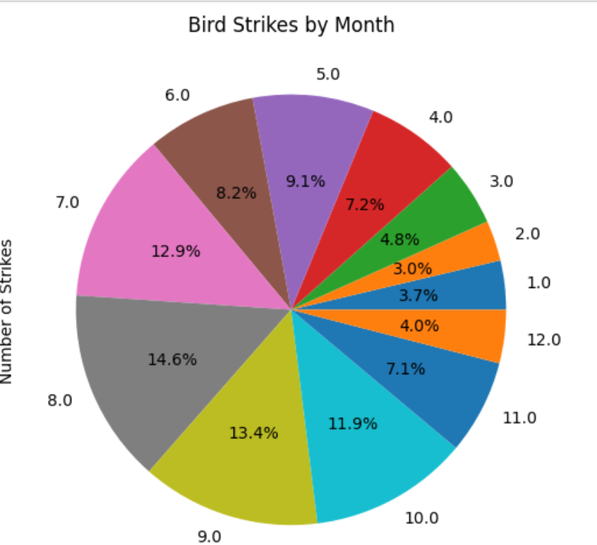
When do most bird strikes occur?
Bird strikes are most likely to occur in summer months (June, July, and August), with August being the peak month (15% of all strikes). This suggests a possible link with increased bird activity and migration patterns.

Slide 10
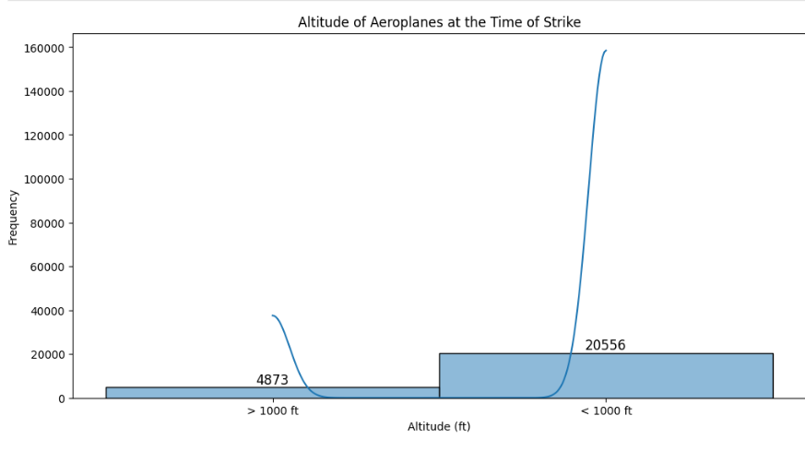
Altitude of aeroplanes at the time of strike
Most bird strikes occur at low altitudes (<1,000 ft), with the highest frequency between 200-400 ft. This highlights the importance of prioritizing low-altitude flight safety in aircraft design, pilot training, and bird strike mitigation strategies.

Slide 11
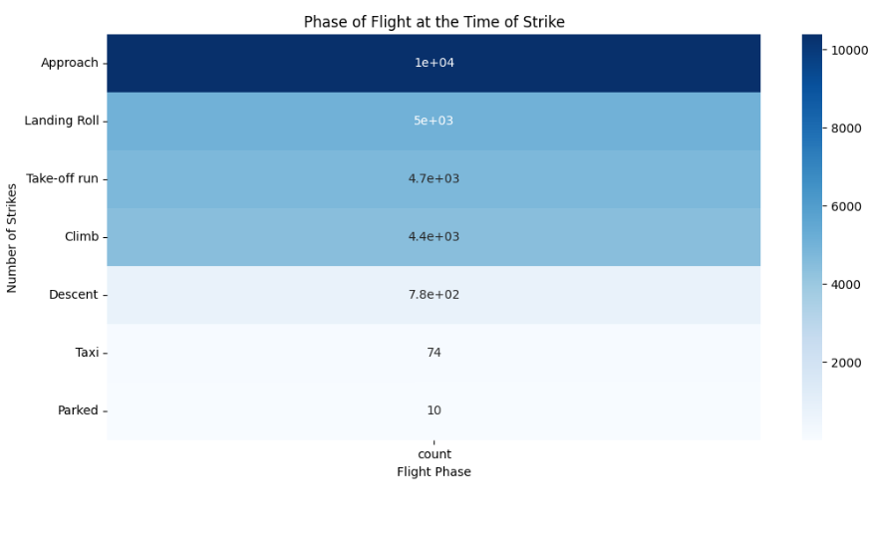
Phase of flight at the time of the strike
The analysis reveals that the majority of bird strikes (over 70%) occur during the takeoff and landing phases of flight, with the highest number of strikes occurring during the landing phase. By prioritizing safety during takeoff and landing, the aviation industry can reduce the risk of bird strikes and ensure safer flights.

Slide 12
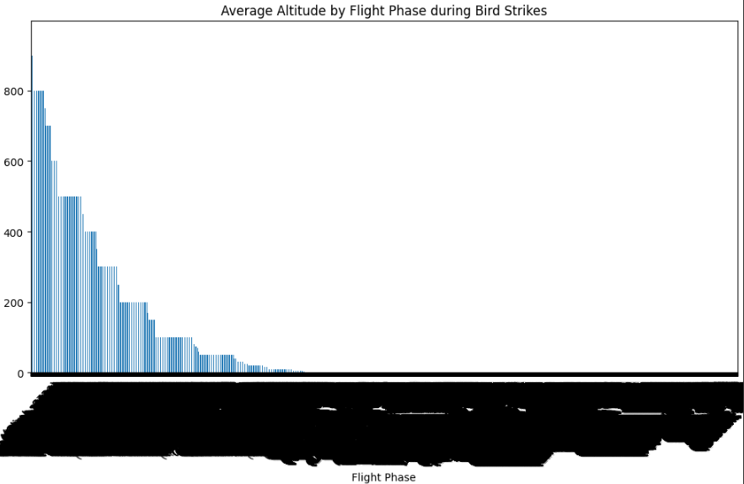
Average Altitude of the aeroplanes in different phases at the time of strike
Bird strikes occur at varying altitudes across flight phases, with highest risk at lower altitudes during takeoff & landing. Understanding altitude patterns can help aviation industries develop targeted safety strategies.

Slide 13
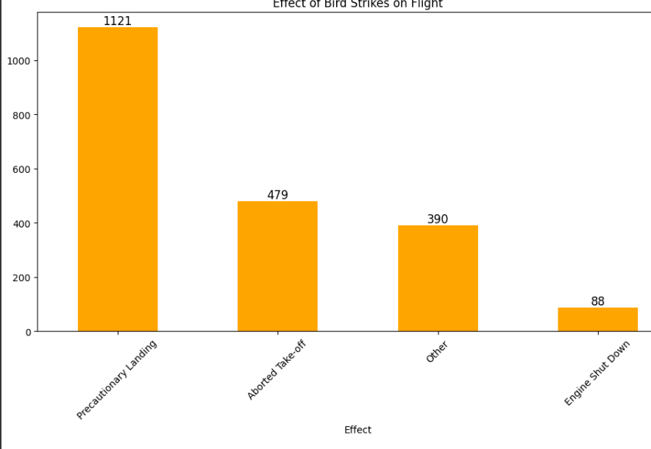
Average Altitude of the aeroplanes in different phases at the time of strike
Most bird strikes cause minor to no impact on flights (73%), while 21% result in significant damage, and 6% lead to flight diversions or cancellations.

Slide 14
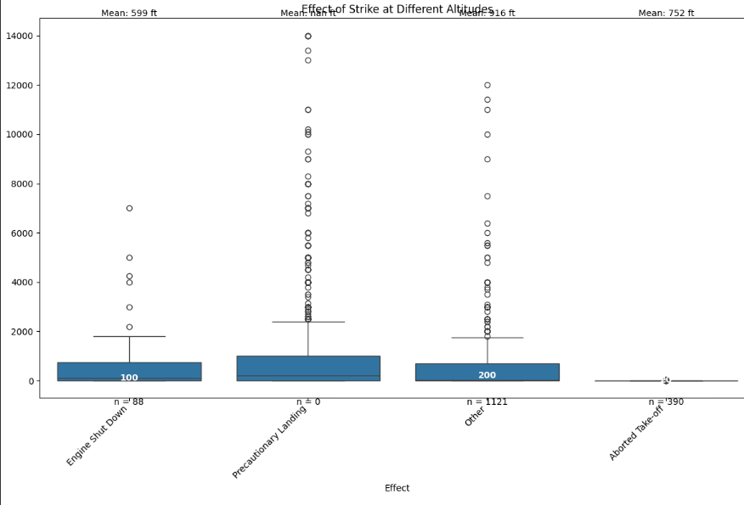
Effect of strike of different altitude
The median altitude of bird strikes varies by impact, with "Minor/No Damage" strikes occurring at lower altitudes (mean: 1,044 ft) and "Significant Damage" strikes at higher altitudes (mean: 2,514 ft).

Slide 15
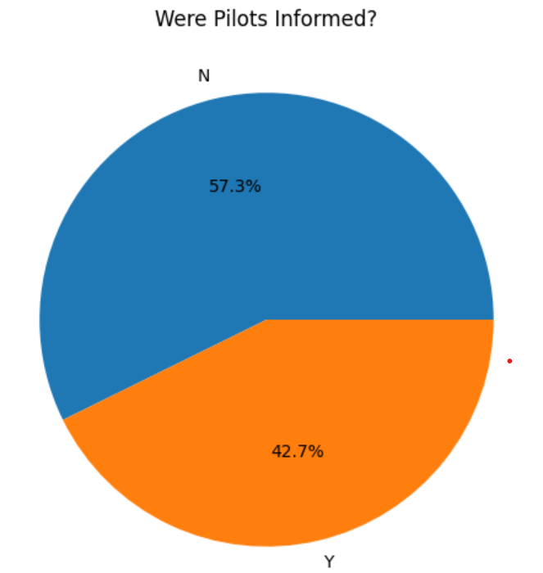
Were Pilots Informed? & Prior Warning and Effect of Strike Relation
Only 12.6% of pilots were warned about birds or wildlife before the strike, highlighting a significant gap in communication and preparedness.
The majority of strikes (87.4%) occurred without prior warning, emphasizing the need for improved bird strike risk management and pilot notification systems.

Slide 16
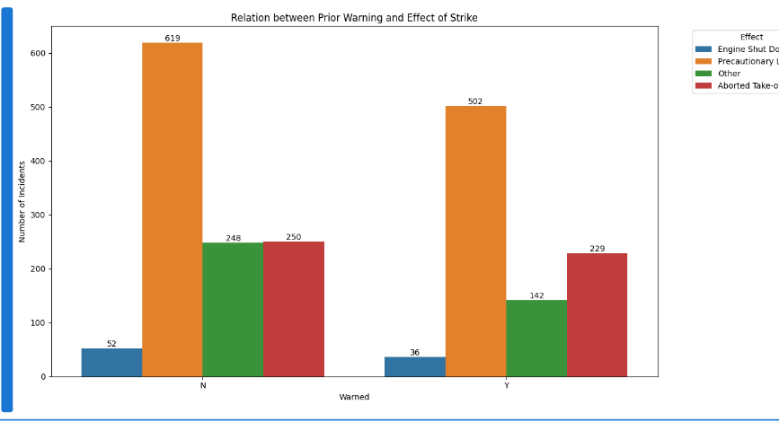
Were Pilots Informed? & Prior Warning and Effect of Strike Relation
Only 12.6% of pilots were warned about birds or wildlife before the strike, highlighting a significant gap in communication and preparedness.
The majority of strikes (87.4%) occurred without prior warning, emphasizing the need for improved bird strike risk management and pilot notification systems.

Slide 17
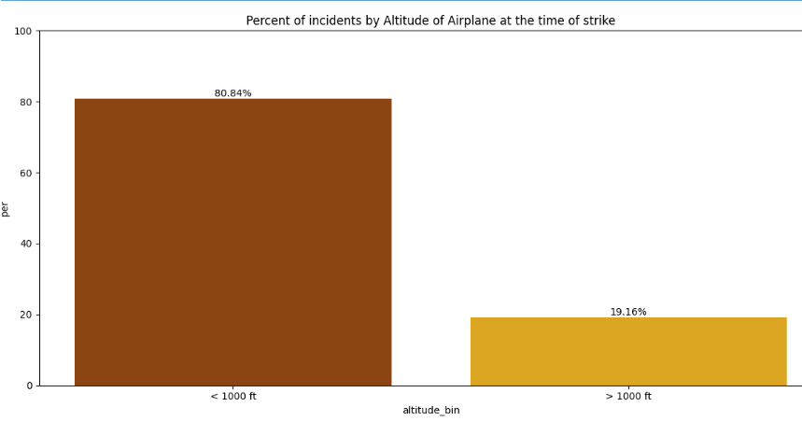
percent of incident by altitude of airplane at the time strike
The majority of bird strikes (80.84%) occur at altitudes below 1000 ft, highlighting the need for enhanced safety measures during takeoff and landing phases.
Only 19.16% of strikes occur at altitudes above 1000 ft, suggesting that most bird strikes are related to low-altitude flights, such as during departure or approach.

Slide 18
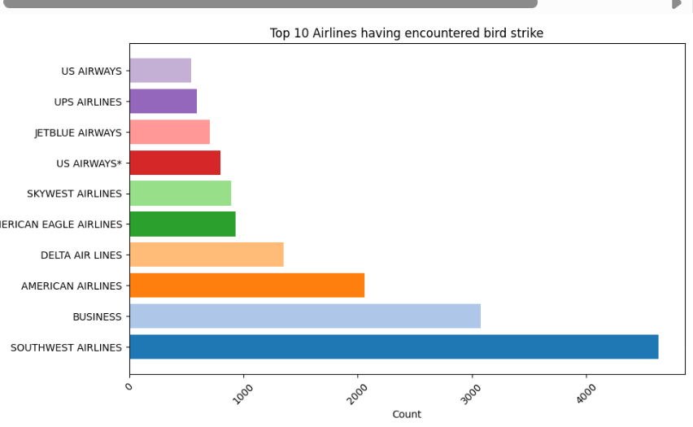
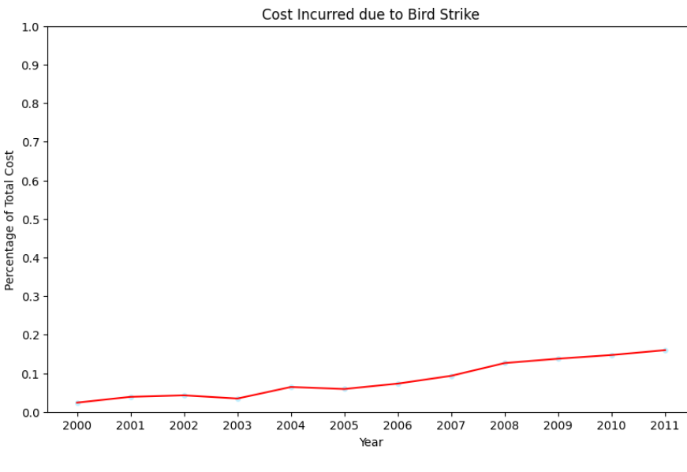
1. Top 10 Airlines having encountered bird strike
2. Cost incurred due to bird strike

Slide 19
Conclusion
42.72% incidents where pilot was warned about the birds
Prior warning to the pilot reduces the risk of damage to the aircraft
52.78% of incidents have happened due to some small unknown bird.
72.9% incidents have happened when there is 1 bird/wildlife is struck in the airplane and caused damage.
90.31% incidents caused no damage while 9.69% incidents caused damage
80.84% of bird strike incidents have happened when the altitude of airplane was <1000 ft and 19.16% have happened when altitude was >1000 ft.
Most of the incidents have happened when there is no cloud in each year

